Slide 1
HK97 Results

Slide 2
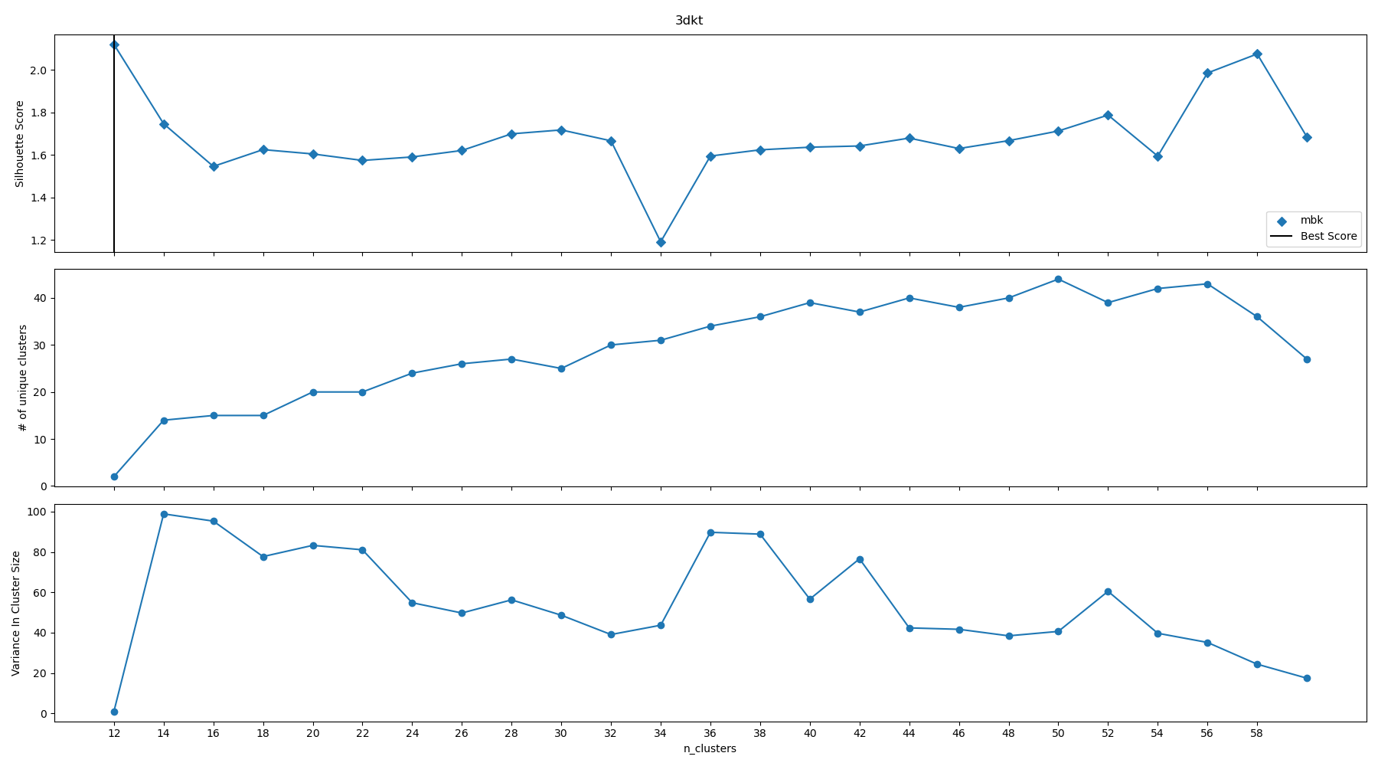
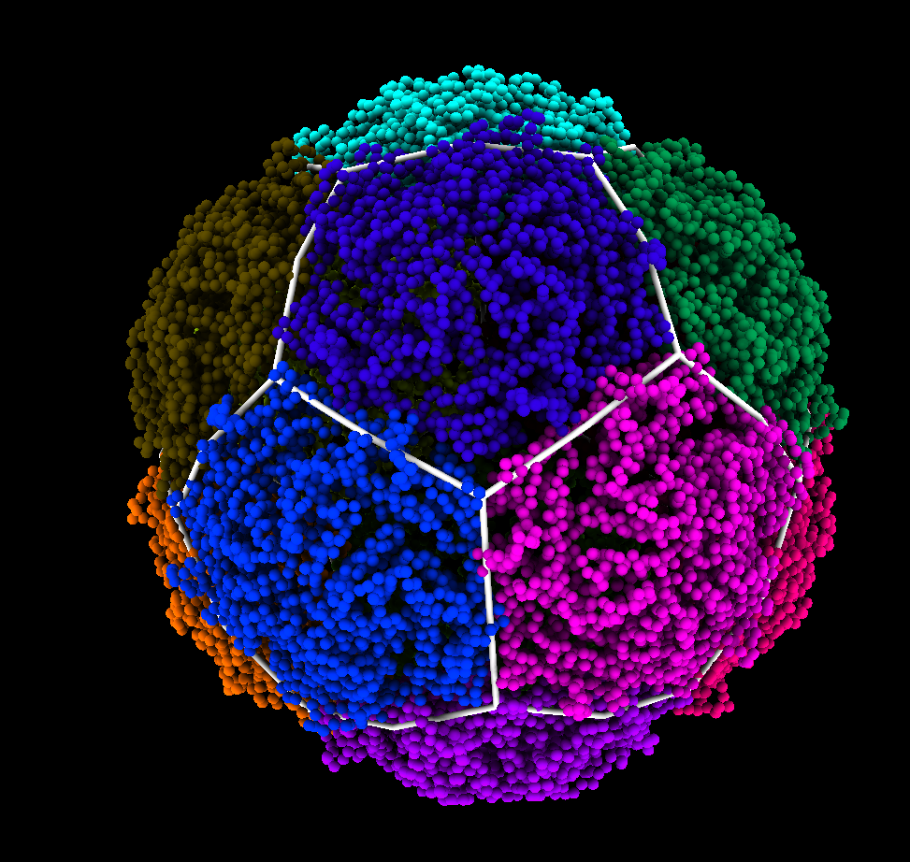
Thermotoga Maritima Encapsulin (3dkt)
T=1 Hexagonal 12 Pentagonal Clusters Containing 5 MCPs

Slide 3
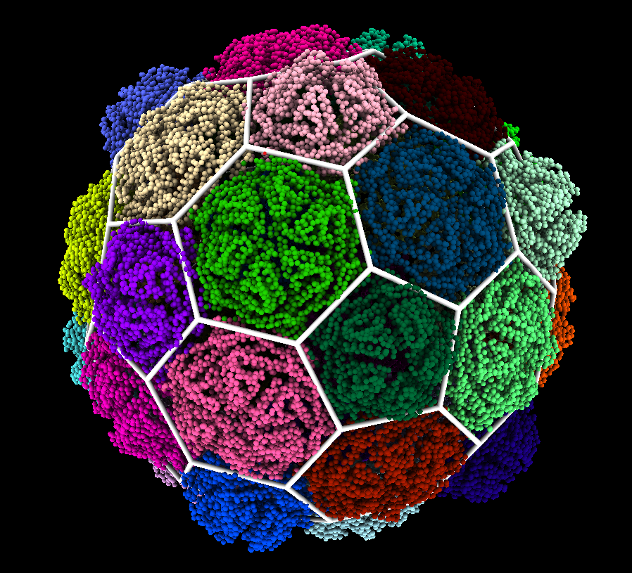
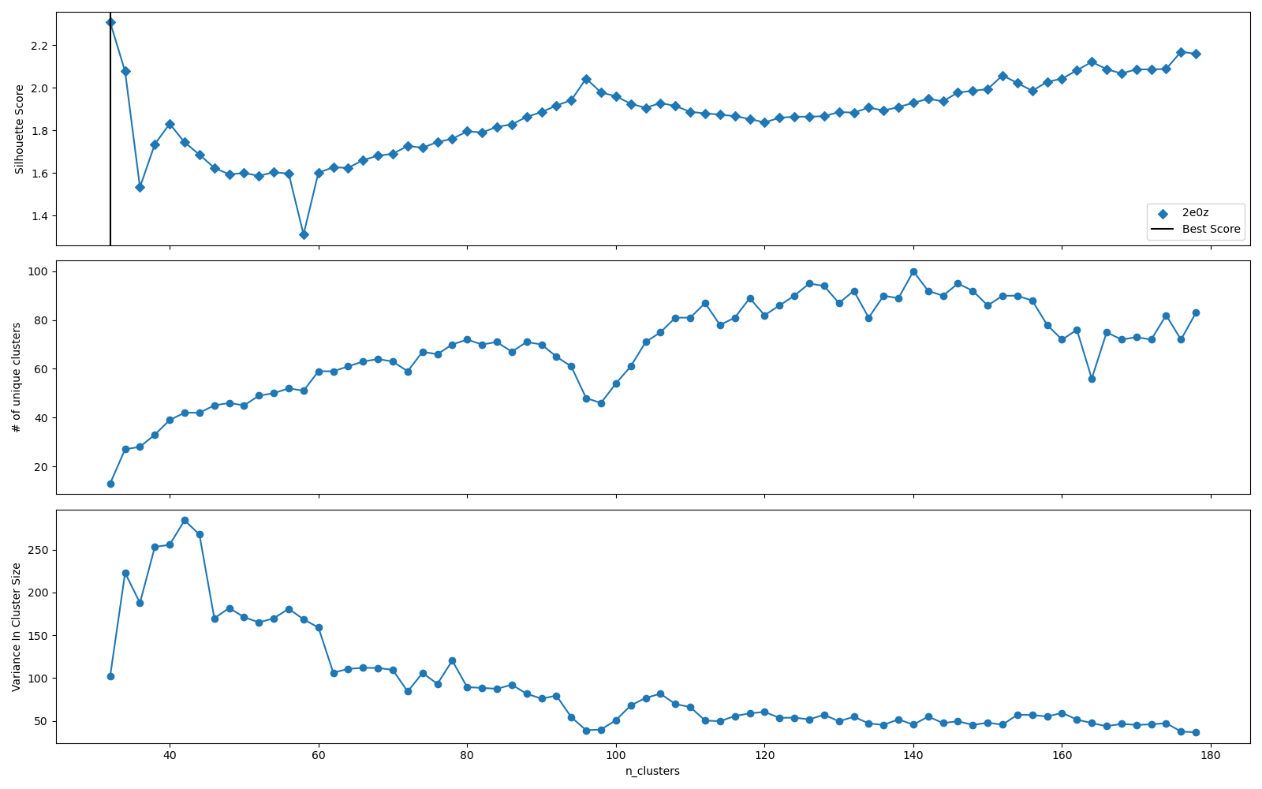
VLP From Pyrococcus Furiosus (2e0z)
T=3 Hexagonal
12 Pentagonal Clusters containing 5 MCPs
20 Hexagonal Clusters containing 6 MCPs

Slide 4
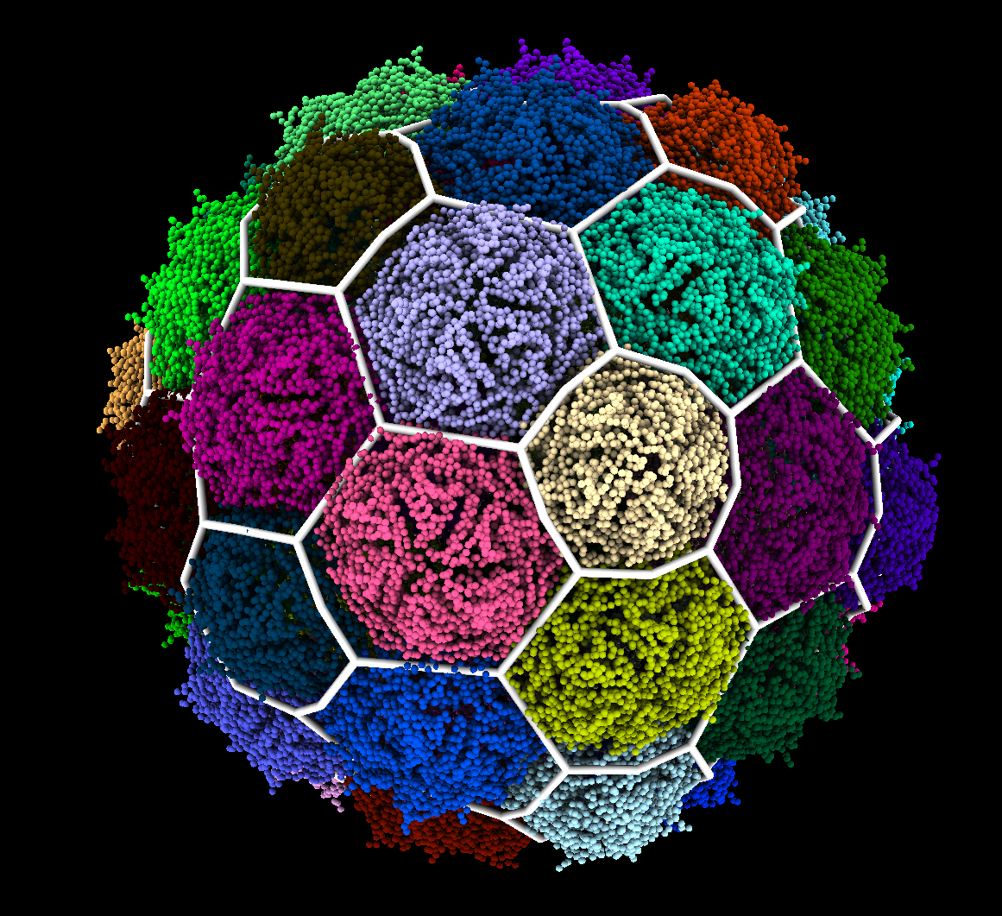
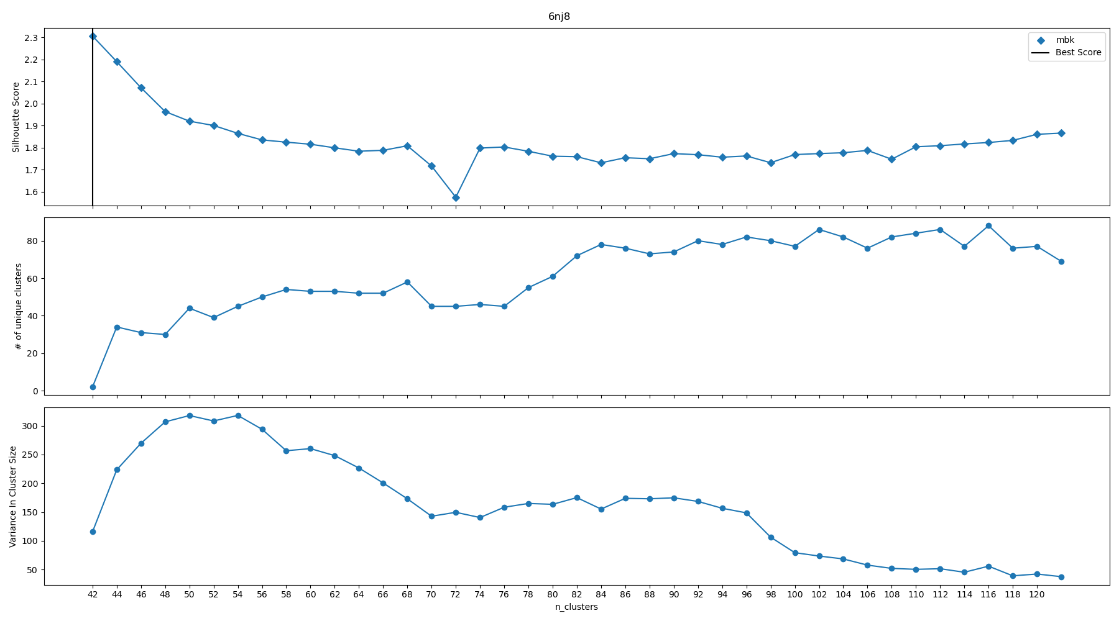
Iron Storage Encapsulin From Quasibacillus thermotolerans (6nj8)
T=4 Hexagonal
12 Pentagonal Clusters containing 5 MCPs
30 Hexagonal Clusters containing 6 MCPs

Slide 5
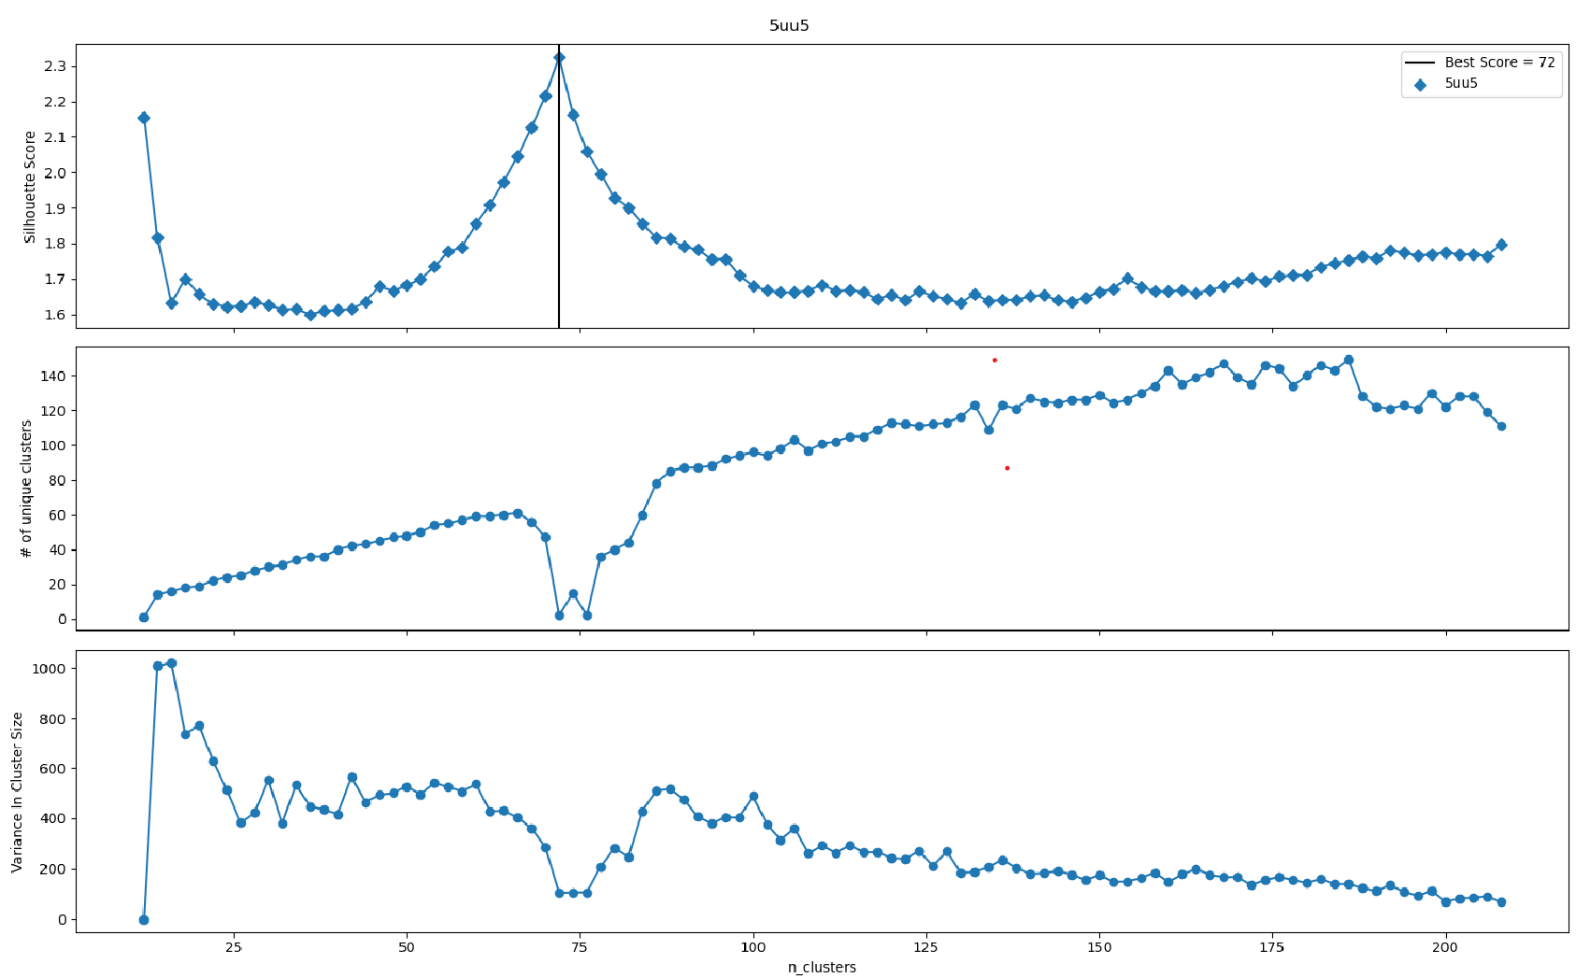
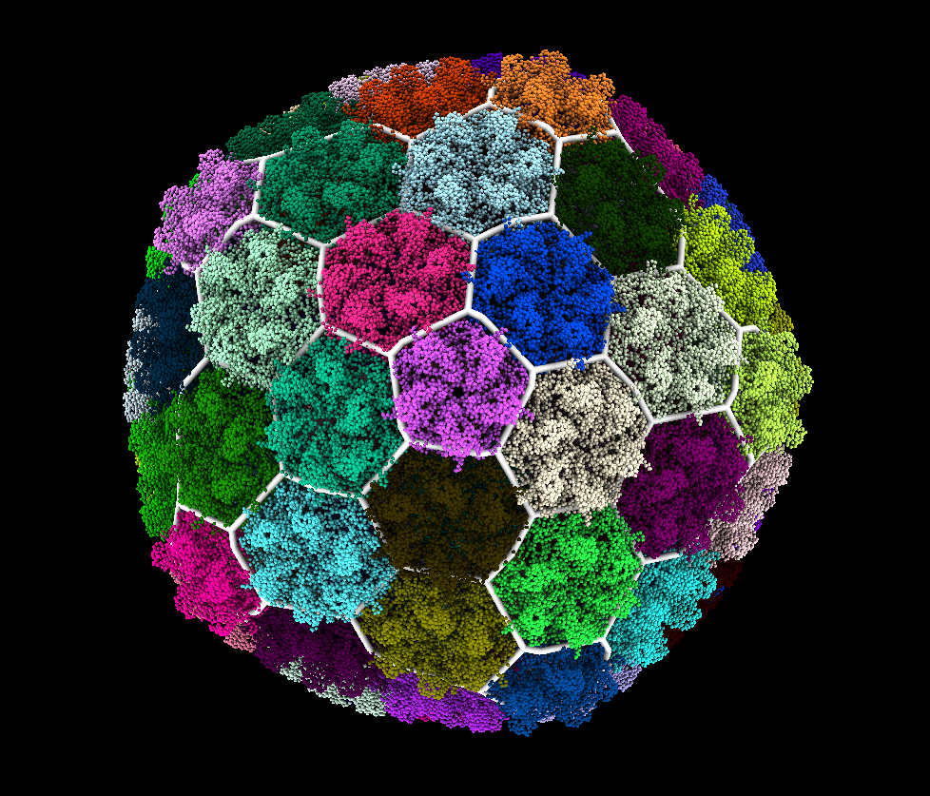
Bacteriopohage P22 Mature Virion (5uu5)
T=7 Hexagonal
12 Pentagonal Clusters containing 5 MCPs
60 Hexagonal Clusters containing 6 MCPs

Slide 6
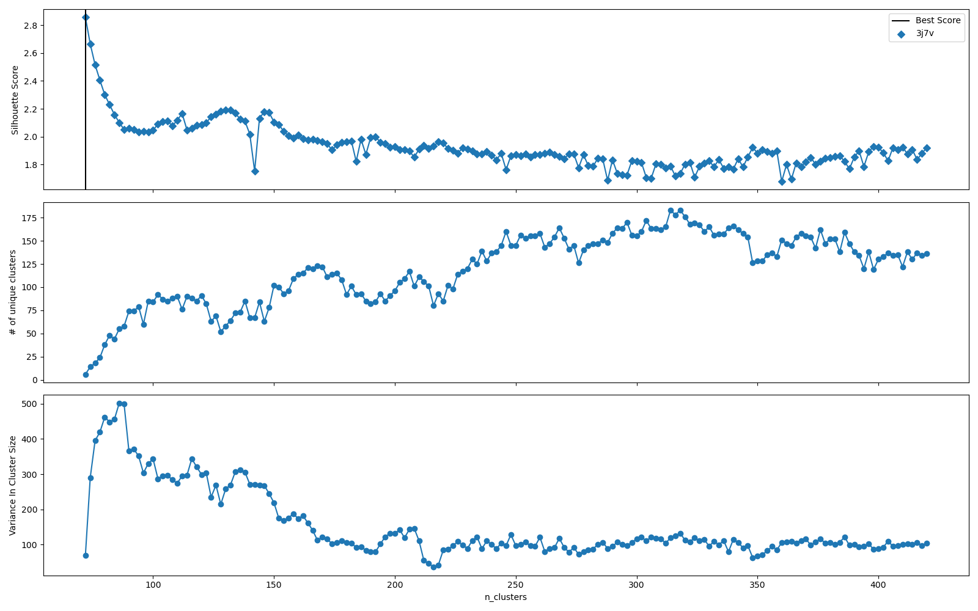
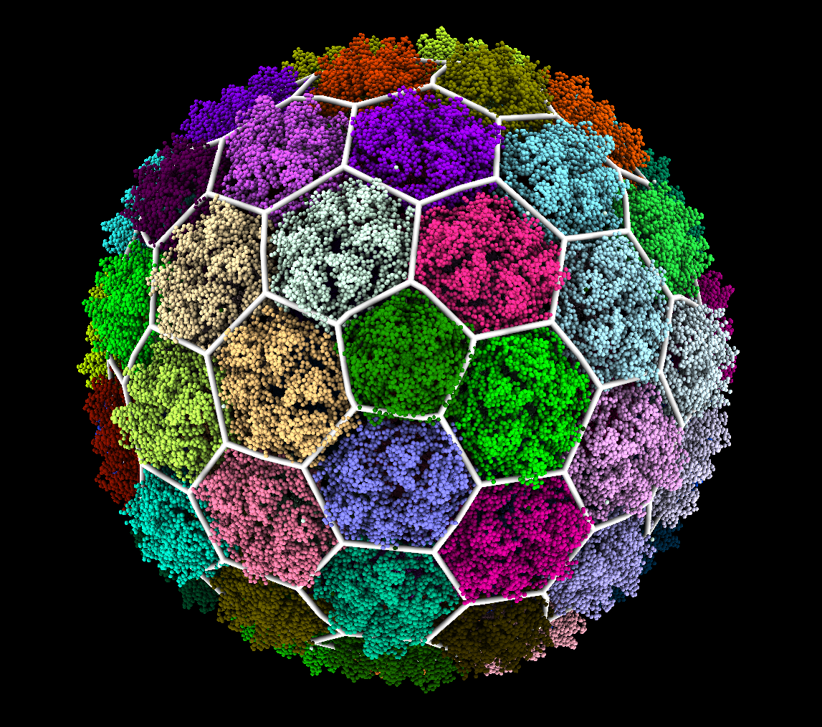
Bacteriopohage T7 Procapsid (3j7v)
T=7 Hexagonal
12 Pentagonal Clusters containing 5 MCPs
60 Hexagonal Clusters containing 6 MCPs

Slide 7
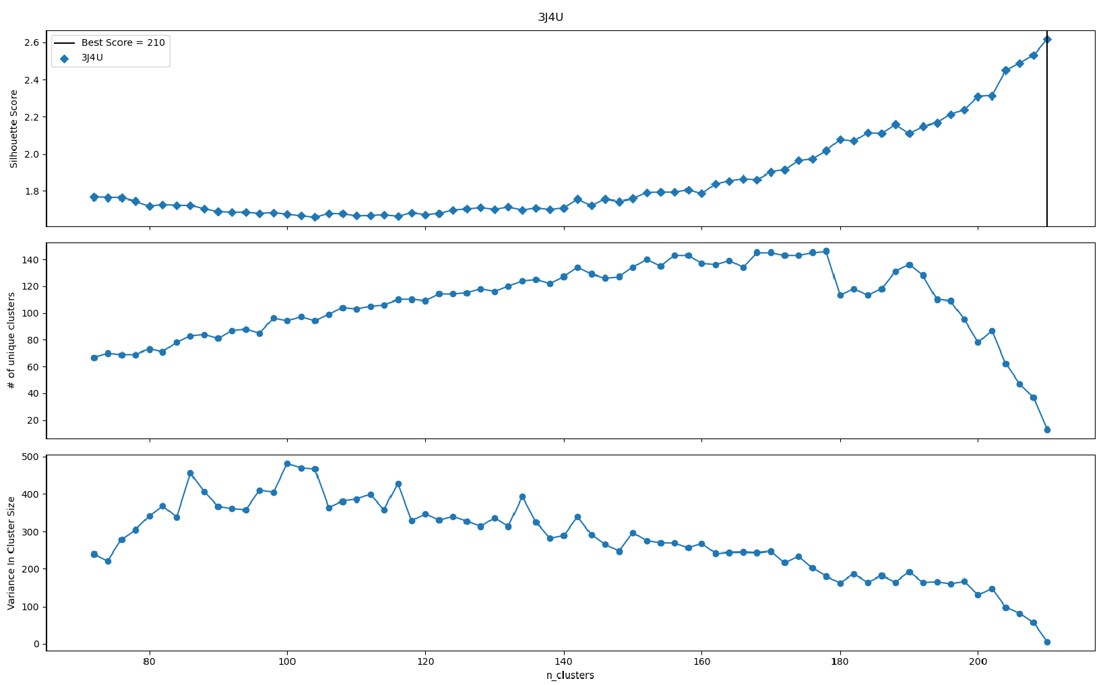
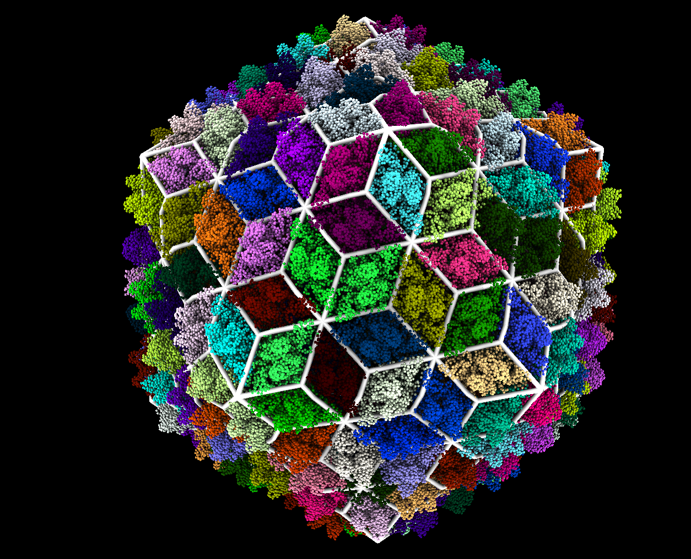
Bordetella Bacteriophage (3j4u)
T=7 Trihex-Dual (Imperfect Clustering)
210 Clusters Containing ~2 MCPs and 2 mCPs

Slide 8
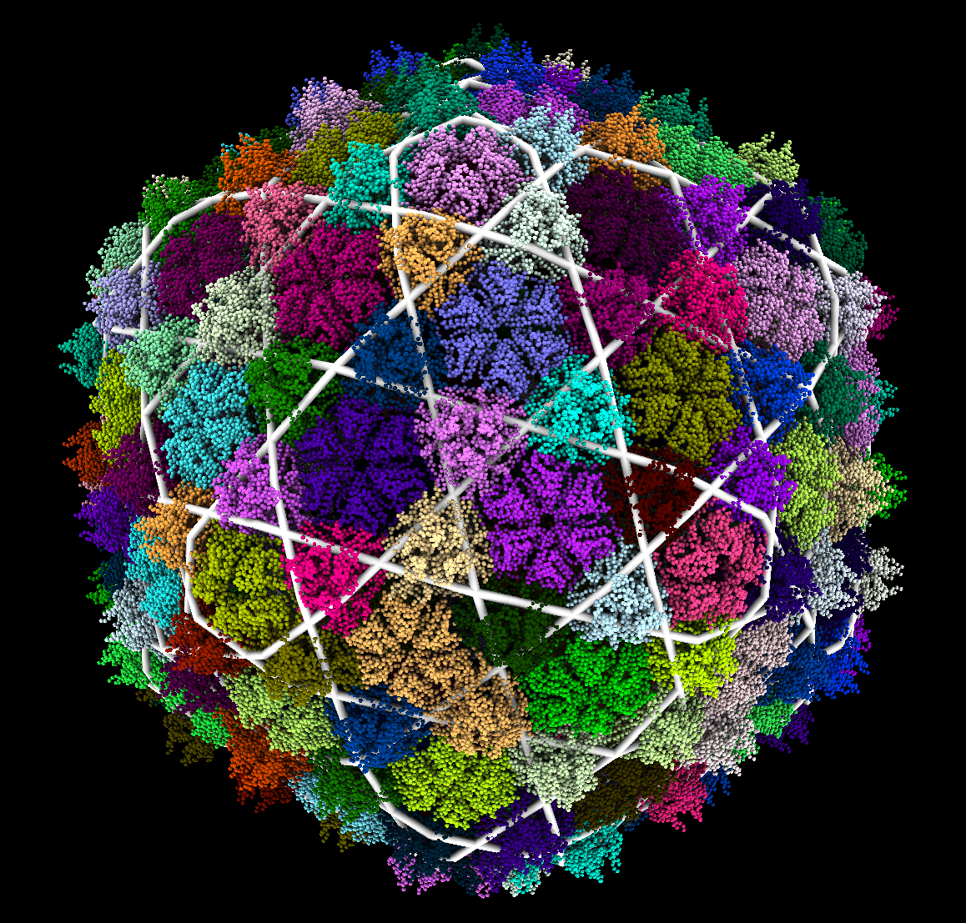
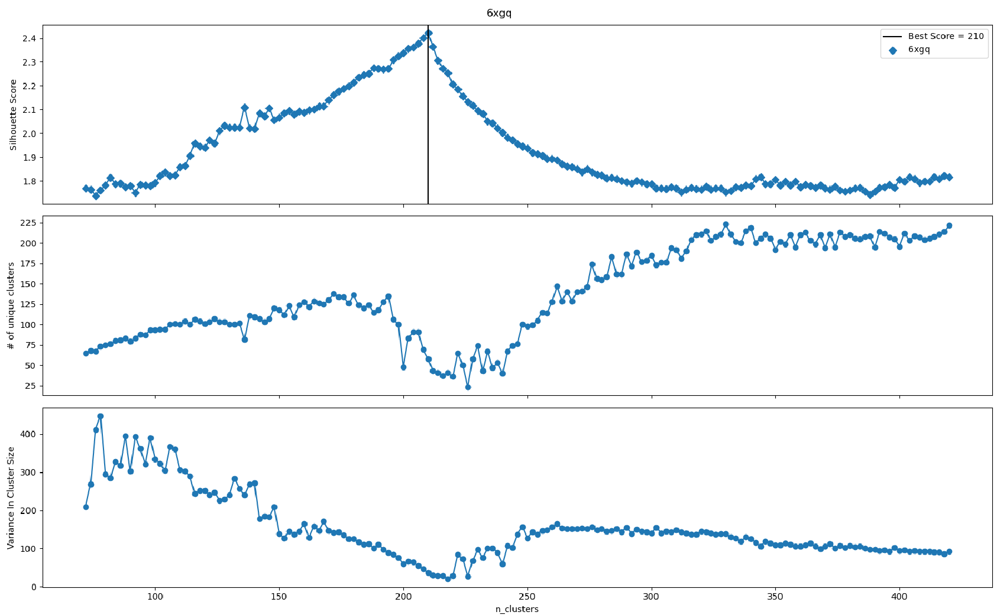
YSD1 Bacteriophage (6xgq)
T=7 Trihexagonal (Imperfect Clustering)
12 Pentagonal Clusters containing 5 MCPs
60 Hexagonal Clusters containing 6 MCPs
140 Triangular Clusters containing 3 mCPs and MCP Extended Domains

Slide 9
Discussion
P22 lacked reinforcement proteins and was labelled as hexagonal
Bordetella and Phage YSD1 had reinforcement proteins around the local 2-fold and 3-fold axes respectively and were labeled as trihex-dual and trihex.
This suggests the presence and location of reinforcement proteins could determine lattice structure.
Both Bordatella and YSD1 had error in their label assignments. The tool becomes less accurate at a large number of clusters.

